Slide 1
CLAS 220 Introduction to Classical Mythology
Virgil, Aeneid 10-12

Slide 2
Quiz Question
Who kills Pallas?
Aeneas
Mezentius
Nisus
Turnus

Slide 3
Quiz Question
2. What is the name of Mezentius’ son?
a. Evander
b. Lausus
c. Pallas
d. Iulus

Slide 4
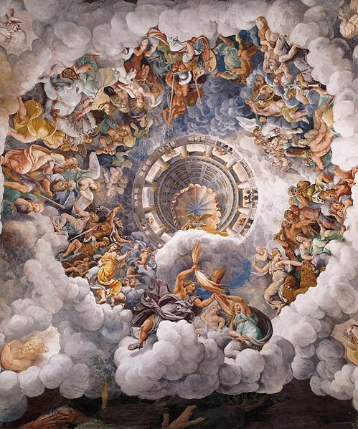
Jupiter speaks in assembly
“Take heed then, and keep fast in memory
These words of mine. Whereas Ausonians
Are not allowed to league themselves with Trojans,
And it is not acceptable to you
To end your discord, therefore I shall hold
Without distinction Rutulians and Trojans,
Whatever fortune each may have today,
Whatever hope may guide him; whether the camp
Lies under siege as fated for Italians
Or through Troy’s blunder, and through prophecies
Malign and dark. Neither do I exempt
The Rutulians. The effort each man makes
Will bring him luck or trouble. To them all
King Jupiter is the same king.
And the Fates Will find their way.”
10.143-57

Slide 5
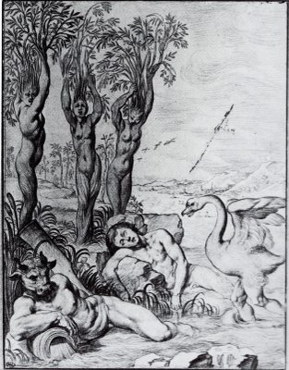
Cycnus
Nor you with your scant following, Cupavo,
Plumage of swan upon your crest: a sign
Reproaching Amor and his goddess mother
With your own father’s change of form.
Cycnus, they say, when mourning Phaethon
In Phaethon’s young sisters’ poplar shade
Among the new leaves, quieting with song
His woe for love lost, dressed himself
In softest plumage as in snowy age
And left the earth and chanting sought the stars.
With crewmen young as he, the son, Cupavo,
Drove ahead with oars the giant Centaur,
Figurehead that towered, threatening
The waves with a great boulder: the tall ship
With long keel driven, furrowed the open sea.
10. 257-271

Slide 6
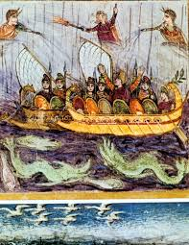
The ship/nymphs speak
“Still awake,
Aeneas, kin to gods? Be wakeful, then,
And slacken off your sheet. We are those pines
From Ida’s holy crest, and once your fleet,
Now become sea nymphs. When the base Rutulian
Bore down on us with sword and fire, headlong
We broke our cables, though against our will.
All through the sea we looked for you. This form
The Mother of Gods in pity fashioned for us,
Allowing us as goddesses to spend
Our lives under the waves. Now learn from us:
The boy, Ascanius, is pinned down behind
His wall and moat, amid attacking spears
Of Latins, rough in onslaught.
10.315-28

Slide 7
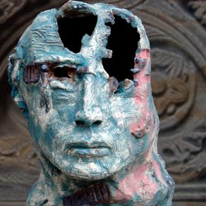
The Good Die Young
Here Pallas strove and pressed; against him, Lausus,
Not much disparate in age, and both
Splendid in height and build; but fortune gave
Neither a homecoming to his native land.
Now, though, the mighty ruler of Olympus
Would not let them encounter one another.
Their fates awaited them, each at the hands
Of a still greater foe.
10.598-606

Slide 8
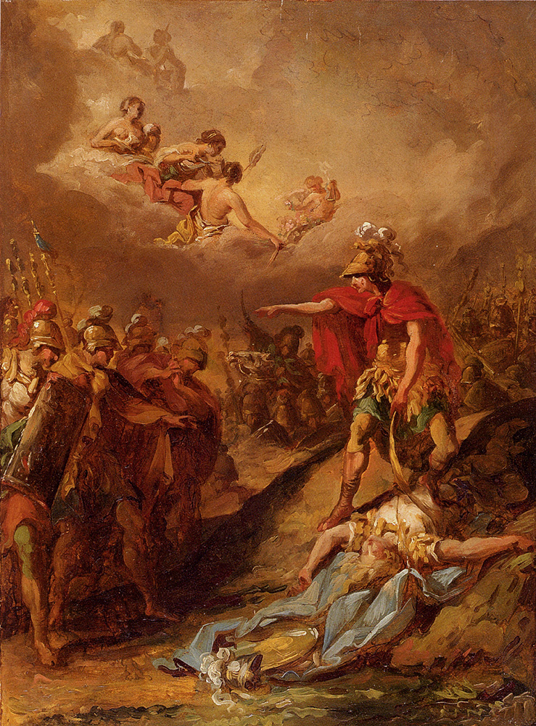
Turnus Kills Pallas
With quivering shock
His point ripped through the center of the shield,
Through all the skins of steel and bronze and bull’s hide
Outer integuments, and then punched through
The cuirass armor and the stalwart chest.
Pallas pulled from the wound the warm spearhead
In vain, for blood and life came out as well
By the same passage. Forward on his torn breast
He plunged, his armor clanging over him,
And bit the hostile earth with bloody mouth
As he gave up his life. Looming above him,
Turnus called: “Arcadians, note well
And take back to Evander what I say:
In that state which his father merited
I send back Pallas. And I grant in full
What honor tombs confer, what consolation
Comes of burial. No small price he’ll pay
For welcoming Aeneas.”
10.671-691

Slide 9
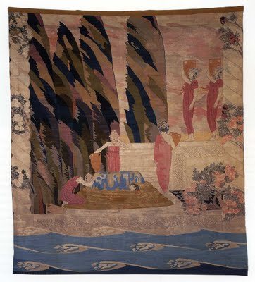
… and takes his swordbelt
He pressed with his left foot upon the dead
And pulled away the massive weight of swordbelt
Graven with pictured crime: that company,
Aegyptus’ sons, killed by Danaus’ daughters,
Young men murdered on one wedding night,
Their nuptial beds blood-stained. Eurytus’ son,
Clonus, had chased the images in gold.
Now Turnus gloried in it, in his winning.
10. 692-700

Slide 10
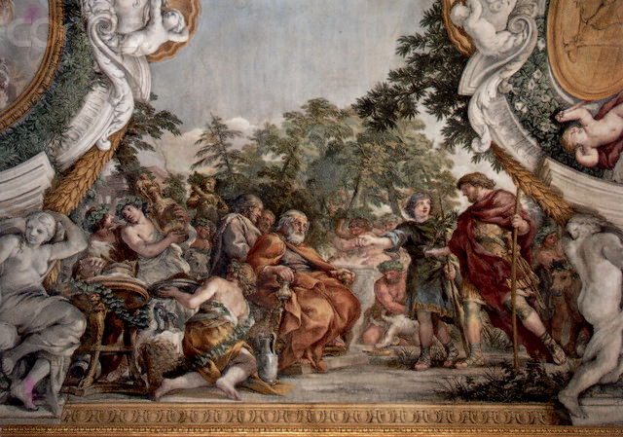
Aeneas’ Wrath
Pallas, Evander: all
Their history rose before Aeneas’ eyes:
The first feast he had come to as a stranger,
The right hands joined in friendship. Now he took
Four sons of Sulmo, four more Ufens reared,
Took them alive to offer to the shades
In sacrifice, wetting with captive blood
The flames of Pallas’ pyre.
10.725-31

Slide 11
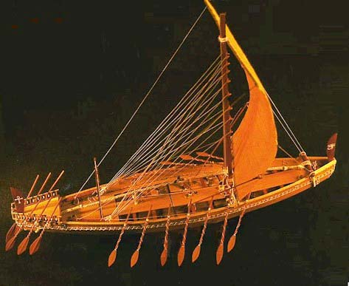
Juno Helps Turnus Escape
One ship,
It happened, stood there moored to a high rock ledge,
Ladders and gangway out: King Osinius
Had sailed in it from Clusium. The distraught
Phantom of Aeneas in flight ran here
To fling itself aboard and under cover.
Hard on its heels, past every obstacle,
Turnus bounded over the steep gangway.
He had scarce reached the prow when Juno broke
The mooring line and wrenched the ship away
Adrift on the ebb of surf. Ashore, Aeneas
Called for the absent man to stand and fight,
While he sent down to earth many a soldier
Met on the field.
10.915-929

Slide 12
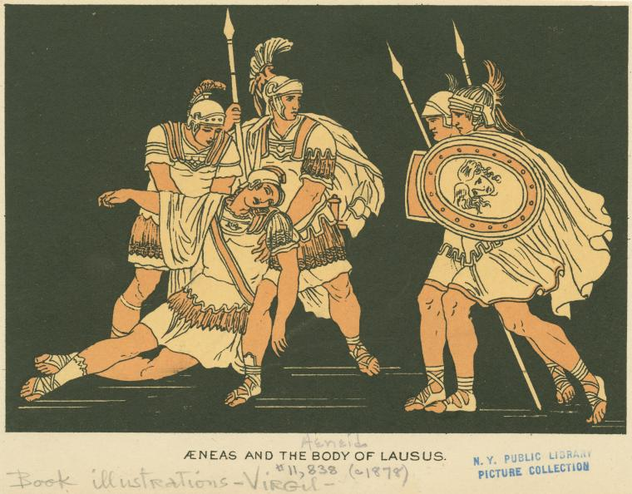
Aeneas Kills Lausus, son of Mezentius
But Lausus all the same leapt to the clash,
Beside himself. Now in the Dardan captain
Anger boiled up higher. The Parcae wound
The thread of Lausus to the end: Aeneas
Drove his tough sword through the young man’s body
Up to the hilt – for it pierced the half-shield, light
Defense for one so menacing – and the shirt
His mother had woven him, soft cloth of gold,
So blood filled up the folds of it. His life
Now left his body for the air and went
In sorrow to the shades. But seeing the look
On the young man’s face in death, a face so pale
As to be awesome, then Anchises’ son
Groaned in profound pity. He held out
His hand as filial piety, mirrored here,
Wrung his own heart…
10. 1138-1154

Slide 13
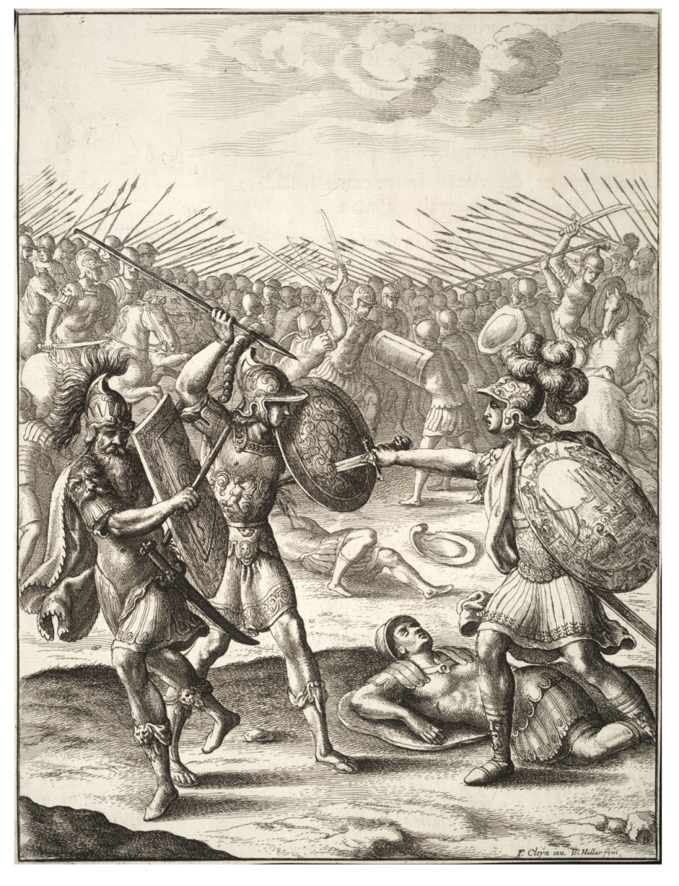
Mezentius Dies
“Bitter as gall, my enemy,
Why pillory me and hold up death before me? Taking my life you do no wrong; I had
No other expectation, coming to battle.
Lausus, my son, made no compact with you
That you should spare me. One request I’ll make
If conquered enemies may ask a favor:
Let my body be hid in earth. I know
On every hand the hatred of my people.
Fend off their fury and allow me room
In the same grave with my son.” This said, he faced
With open eyes the sword’s edge at his throat
And poured his life out on his armored breast
In waves of blood.
10.1260-1276

Slide 14
Quiz Question
3. What is the name of the great female warrior in the Aeneid?
a. Cassandra
b. Zenobia
c. Penthisilea
d. Camilla

Slide 15
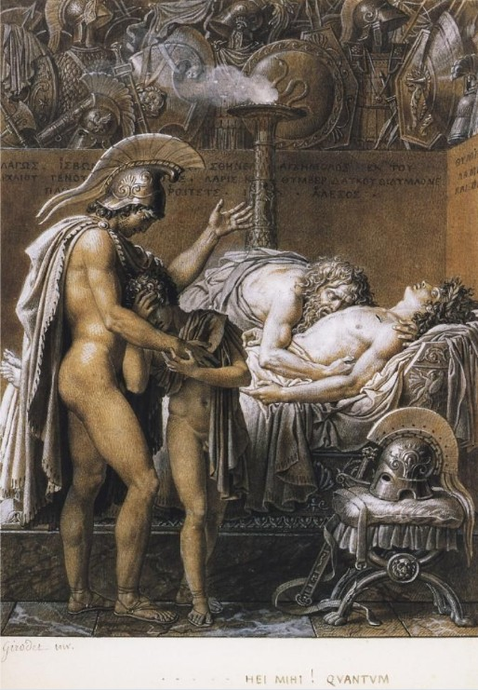
Care for the young dead
When Dawn came up from Ocean in the east,
Though Pallas’ death had left Aeneas shaken,
And duty pressed him to give time
For burial of the dead, he first
In early light discharged his ritual vows
As victor to the gods. A big oak trunk
Lopped of its boughs, he planted on a mound
And dressed it with Mezentius’ bright gear
To make a trophy, god of war, to thee.
He fitted it with a crest still oozing blood,
With javelins of the warrior, and his cuirass,
Twelve times cut and breached.
11.1-12

Slide 16
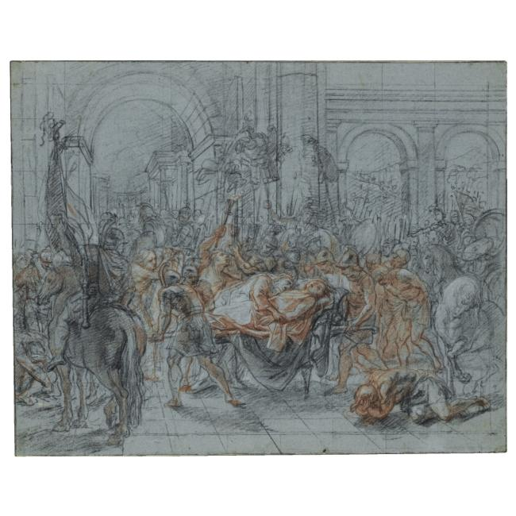
A Funeral for Pallas
“Evander, you will see no shameful wound
Of one who ran, hit from behind; you’ll pray
For no hard death because a son lives on
Disgraced…
Here on his rustic bed there lay the prince,
Most like a flower a girl’s fingers plucked,
Soft-petaled violet or hyacinth
With languid head, as yet not discomposed
Or faded, though its mother earth no longer
Nourishes it and makes it stand in bloom.
Aeneas brought two robes all stiff with gold
Embroidery and purple. Dido of Sidon
Herself had loved the toil of making these
With her own hands one day for him, inweaving
Golden threads into the fabric.
11.74-77; 90-100

Slide 17
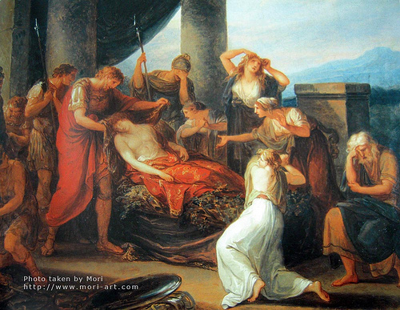
Evander Praises His Dead Son
But if my son had early death before him
I can rejoice that first he took the lives
Of countless Volscians, that he met his end
Leading the Trojans into Latium.
Besides, I could not wish a funeral
More noble for you, Pallas, than this one
Aeneas in his piety performs,
With Phrygian leaders and Etruscan captains,
All the Etruscan army. Men to whom
Your sword-arm dealt out death are here as trophies,
Great ones; you, too, Turnus, would stand here,
A huge trunk hung with arms, had age and strength
And seasoning of years matched him with you.
11. 229-240

Slide 18
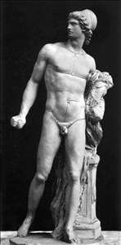
Latinus’ Embassy to Diomedes Fails
“We who did violence to the Ilian land
With cold steel – and now I pass over pain
Endured in warfare under those high walls
And soldiers the Simois there holds under –
All of us have paid throughout the world
Beyond belief in suffering for our crimes,.
Priam himself might pity the lot of us…
No, no,
Invite me to no warfare such as this.
Troy fallen, I have no quarrel with Trojans,
No delight in calling up evil days.
The gifts you bring me from your country, take
Instead to Aeneas.
11. 346-52; 377-82

Slide 19
Drances Blames Turnus
Then Drancës rose, belligerent as before.
The fame of Turnus galled him, made him smart
With envy unconfessed, this wealthy man,
A lavish spender and an orator
But a cold hand in battle; held to be
No empty counselor; a strong party man.
His mother’s nobility made him arrogant,
Though he had no certain father. Now he spoke
To add to and to aggravate their anger:
11.454-462

Slide 20
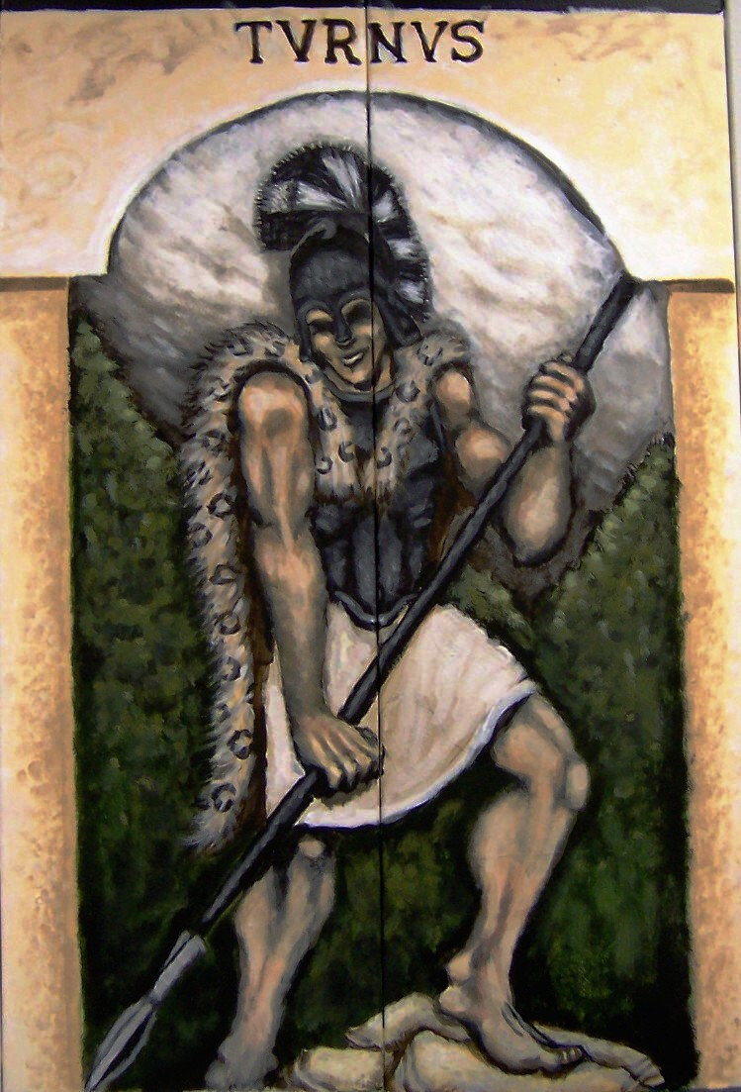
Turnus agrees to fight Aeneas 1 on 1
But if the Trojans call on me alone
For combat, and if you approve, and I
Am blocking something for the good of all,
Then Victory has not so bitterly
Hated these hands and so eluded them
That I should not, in such a hopeful cause,
Make my attempt. And cheerfully I’ll go
Against him, though he overshadow Achilles,
And wear gear made, like his, by Vulcan’s hands.
11.585-93

Slide 21
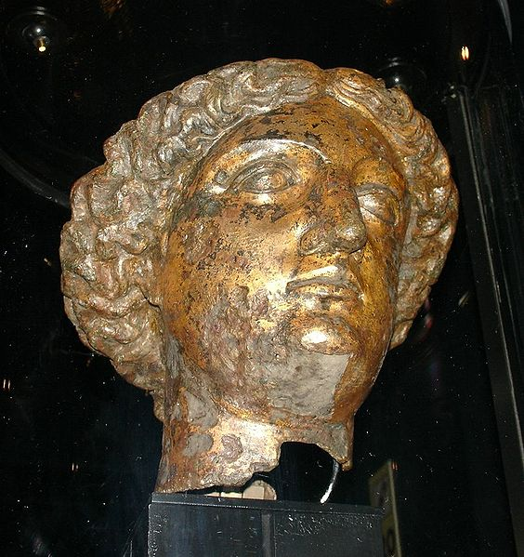
The Latin Women Pray
The queen as well
Rode in her carriage with a company
Of mothers to the shrine of Pallas, high
Above the town, with gifts, and close beside her
The young princess, Lavinia, rode – the cause
Of so much suffering, lovely eyes downcast.
The women, entering, beclouded all
That shrine with smoke of incense, and sad voices
Rose from the portal in a tide of prayer:
“O power over battle, our protectress,
Virgin, Tritonia, shatter in thy hand
The spearhaft of the Phrygian corsair! Throw him headlong to earth, let him lie dead
Below our high gates!”
11. 648-661

Slide 22
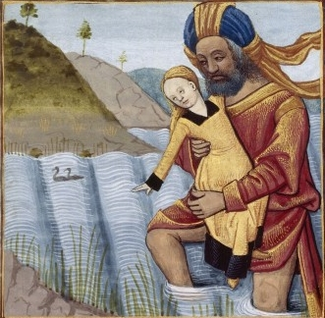
Camilla’s Story
He chanced to carry a battle-spear of oak,
Knotted and seasoned; now to this he tied
His child, encased in cork-tree bark, and bound her
Trimly in the middle of the shaft.
He balanced it in his big hand and prayed
To the air of heaven: “Daughter of Latona,
Diana, kindly virgin of the groves,
I, her father, swear this child will be
Thy servant –the first weapon she embraces
Thine, as by mercy through the air
She escapes the enemy. I beg thee, goddess,
Take her as thine own, this girl committed
Now to the veering wind.”
11.752-65

Slide 23
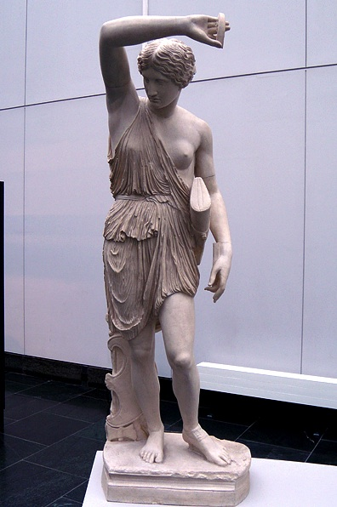
Camilla’s Finest Hour
Amid the carnage, like an Amazon,
Camilla rode exultant, one breast bared
For fighting ease, her quiver at her back.
At times she flung slim javelins thick and fast,
At times, tireless, caught up her two-edged axe.
The golden bow, Diana’s weapon, rang
Upon her shoulders: yes, when she gave ground,
Forced to retreat, with bow unslung in fight
She turned and aimed her arrows. At her side
Rode chosen comrades, virgins all…
11.881-890

Slide 24
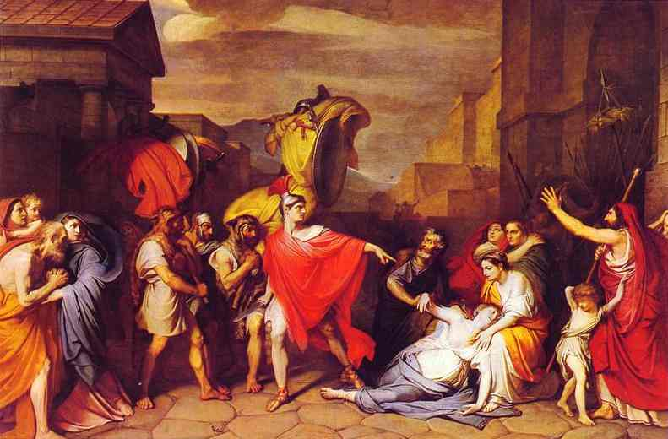
Camilla’s Death
“The man himself [Arruns], splendid in rust and purple,
Out of the strange East, drew a Lycian bow
To shoot Gortynian arrows: at his shoulder
Golden was the bow and golden too
The helmet of the seer, and tawny gold
The brooch that pinned his cloak as it belled out
And snapped in wind, a chlamys, crocus-yellow.
Tunic and trousers, too, both Eastern style,
Were brilliant with embroidery. Camilla
Began to track this man, her heart’s desire
Either to fit luxurious Trojan gear
On a temple door, or else herself to flaunt
That golden plunder. Blindly, as a huntress,
Following him, and him alone, of all
Who took part in the battle, she rode on
Through a whole scattered squadron, recklessly,
In a girl’s love of finery.
11. 1050-1066

Slide 25
Quiz Question
4. Whose one-on-one combat closes the poem?
a. Aeneas and Latinus
b. Latinus and Turnus
c. Ascanius and Lausus
d. Aeneas and Turnus

Slide 26
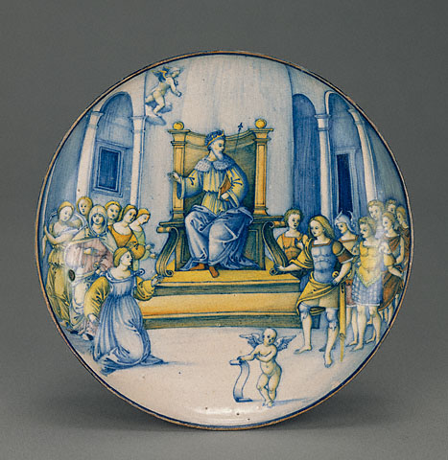
Amata Begs Turnus Not to Fight Aeneas
But now the queen, Amata, terrified
By the new hazard of the single combat,
Wept and pale as death clung to her ardent
Son-in-law: “Turnus, I beg you by these tears,
By all you hold at heart for me, Amata –
You our one hope, our stay in grim old age –
Latinus’ honor and authority
Rest in your hands, all our declining house
Now leans upon you: this one thing I beg: Refrain from single combat with the Trojans.
Any mischance that awaits you there
Awaits me, too; for with you I’ll forsake
This hostile daylight. Never as a captive
Shall I look on Aeneas as my son.”
12. 77-91

Slide 27

Lavinia Blushes
Lavinia, listening to her mother, streamed
With tears on burning cheeks; a deepening blush
Brought out a fiery glow on her hot face.
As when one puts a stain of crimson dye
On ivory of India, or when
White lilies blush, infused with crimson roses,
So rich the contrast in her coloring seemed.
Desire stung the young man as he gazed,
Rapt, at the girl. He burned yet more for battle…
12.92-100

Slide 28
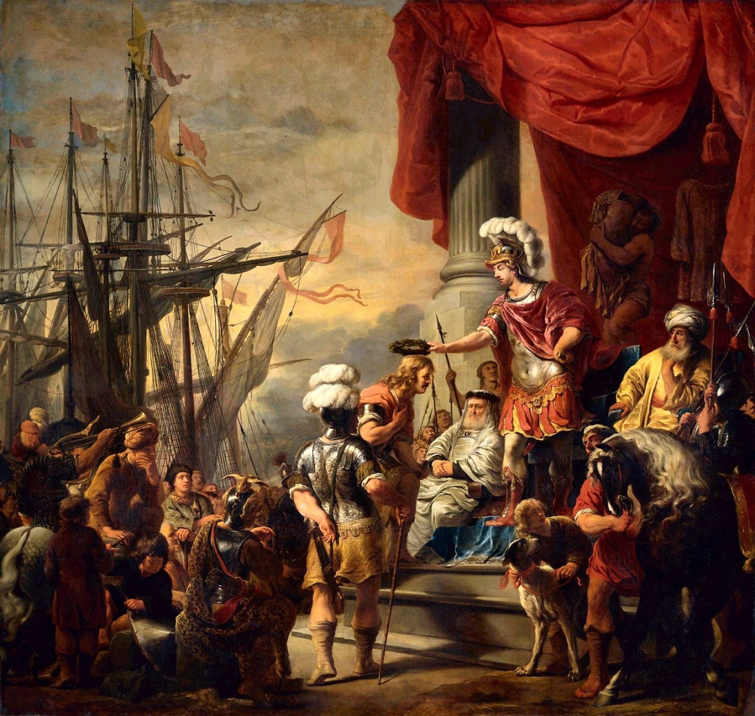
Latinus and Aeneas Strike a Bargain
Should victory fall to the Ausonian, Turnus,
It is agreed that in defeat we shall
Retire upon Evander’s town, that Iulus
Quit this region, and Aeneas’ people
Never afterward return in war
Or send this kingdom challenges to arms.
If on the other hand the day is ours,
Conferred by divine Victory, as I think –
And may the gods confirm it by their will –
I shall not make Italians underlings
To Trojans. For myself I ask no kingdom.
Let both nations, both unconquered, both
Subject to equal laws, commit themselves
To an eternal union. I shall give
Rituals and gods to both.
12. 246-260

Slide 29
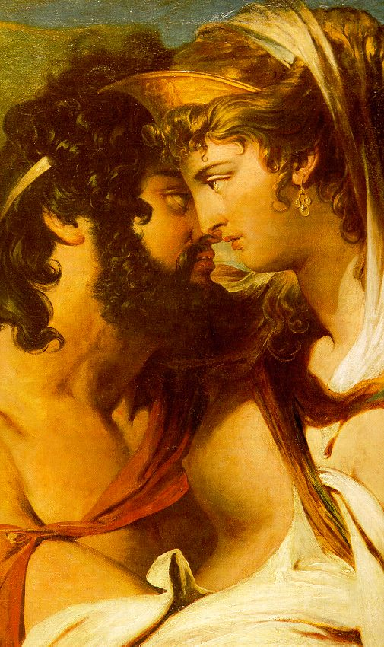
Jupiter and Juno Strike a Bargain
I yield now, and for all my hatred leave
This battlefield. But one thing not retained
By fate I beg for Latium, for the future
Greatness of your kin: when presently
They crown peace with a happy wedding day –
So let it be – and merge their laws and treaties,
Never command the land’s own Latin folk
To change their old name, to become new Trojans,
Known as Teucrians; never make them alter
Dialect or dress. Let Latium be.
Let there be Alban kings for generations,
And let Italian valor be the strength
Of Rome in after times. Once and for all
Troy fell, and with her name let her lie fallen. 12. 1110-1123

Slide 30
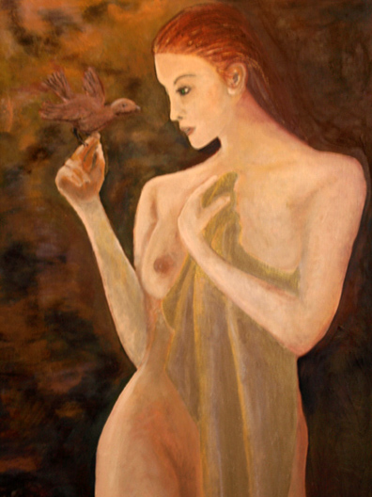
Juturna Withdraws
“Turnus, how can your sister help you now? What action still is open to me, soldierly
Though I have been? Can I by any skill
Hold daylight for you? Can I meet and turn
This deathliness away? Now I withdraw,
Now leave this war…
I recognize, that ghastly sound, and guess
Great-hearted Jupiter’s high cruel commands.
Returns for my virginity, are they? He gave me life eternal – to what end? Why has mortality been taken from me? Now beyond question I could put a term
To all my pain, and go with my poor brother
Into the darkness, his companion there.”
12. 1180-1194

Slide 31
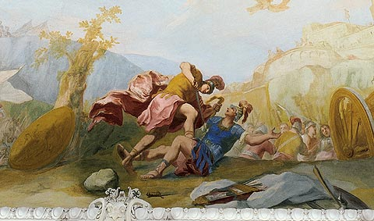
Aeneas Wounds Turnus, Who Begs for Mercy
“Clearly I earned this, and I ask no quarter.
Make the most of your good fortune here.
If you can feel a father’s grief – and you, too,
Had such a father in Anchises – then
Let me bespeak your mercy for old age
In Daunus, and return me, or my body,
Stripped if you will of life, to my own kin.
You have defeated me. The Ausonians
Have seen me in defeat, spreading my hands.
Lavinia is your bride. But go no further
Out of hatred.” 12. 1266-1276

Slide 32
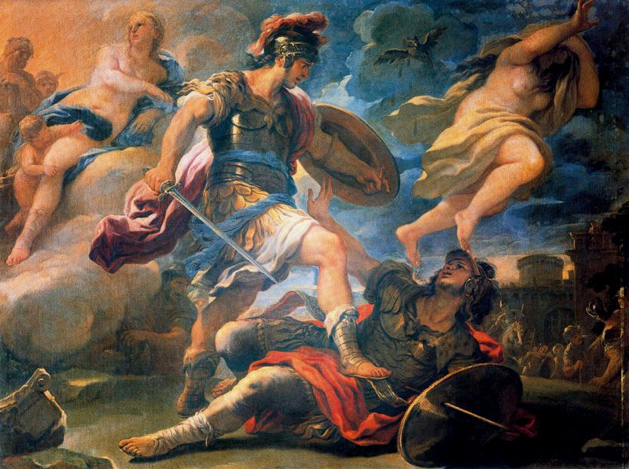
Mercy Refused
Fierce under arms, Aeneas
Looked to and fro, and towered, and stayed his hand
Upon the sword-hilt. Moment by moment now
What Turnus said began to bring him round
From indecision. Then to his glance appeared
The accurst swordbelt surmounting Turnus’ shoulder,
Shining with its familiar studs – the strap
Young Pallas wore when Turnus wounded him
And left him dead upon the field; now Turnus
Bore that enemy token on his shoulder –
Enemy still. For when the sight came home to him, Aeneas raged at the relic of his anguish
Worn by this man as trophy. Blazing up
And terrible in his anger, he called out:
“You in your plunder, torn from one of mine,
Shall I be robbed of you? This wound will come
From Pallas: Pallas makes this offering
And from your criminal blood exacts his due.
He sank his blade in fury in Turnus’ chest.
Then all the body slackened in death’s chill,
And with a groan for that indignity
His sprit fled into the gloom below.
12. 1276-1298
Roman, remember by your strength to rule
Earth’s peoples – for your arts are to be these: To pacify, to impose the rule of law,
To spare the conquered, battle down the proud.”
6.1151-1154

Slide 33
Quiz Question
5. What are the Latins allowed to keep as a result of Juno’s compromise with Jupiter?
a. Their army
b. Turnus’ life
c. their language
d. Nothing

